Slide 1

Online & advanced parking system
Team Members:
Ashish Solanki 20/49017
Komal Jolaniya 20/49035
Vinay 20/49061

Slide 2
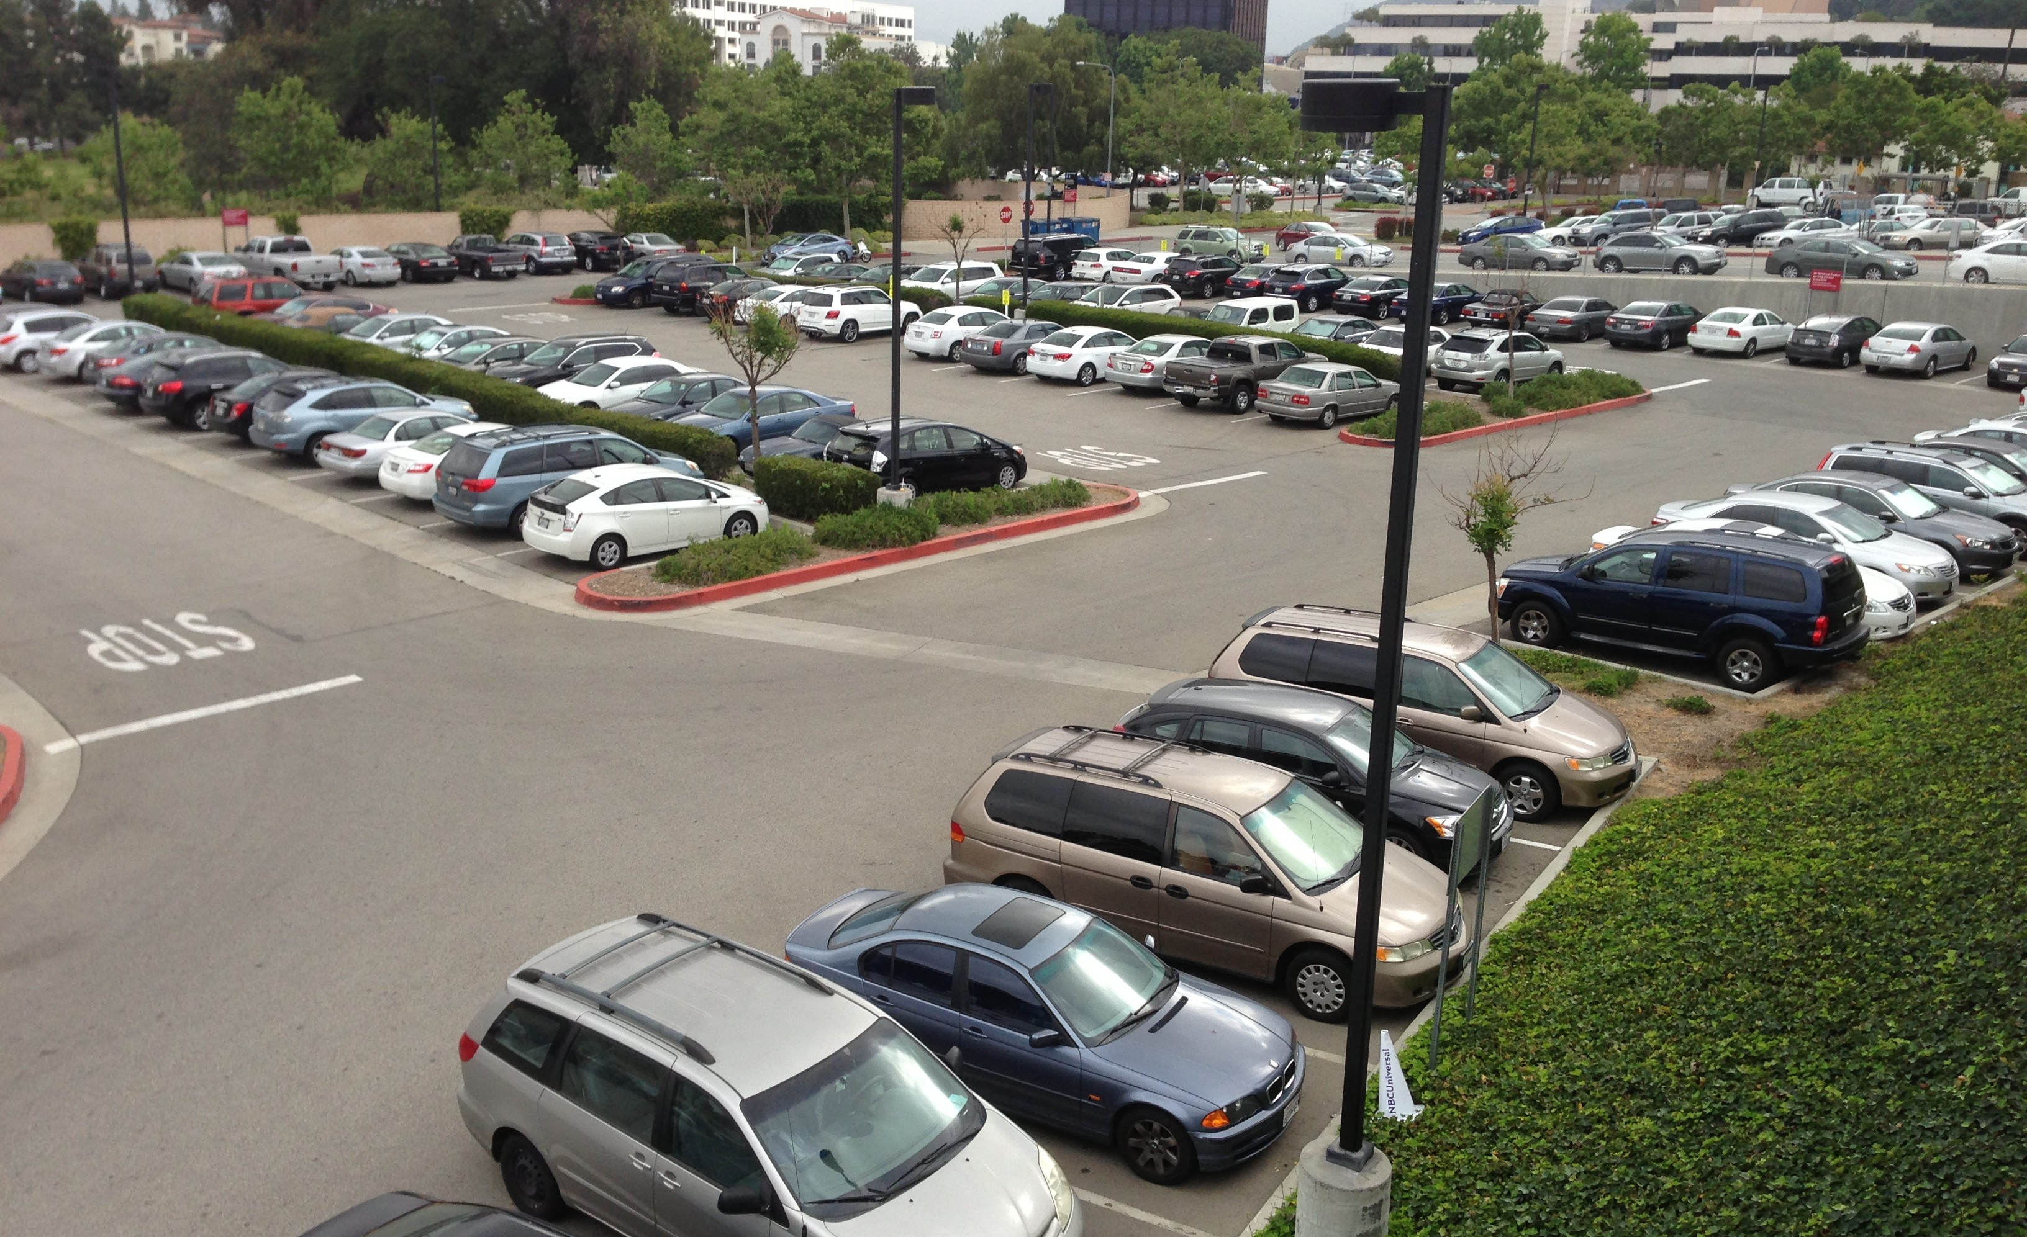
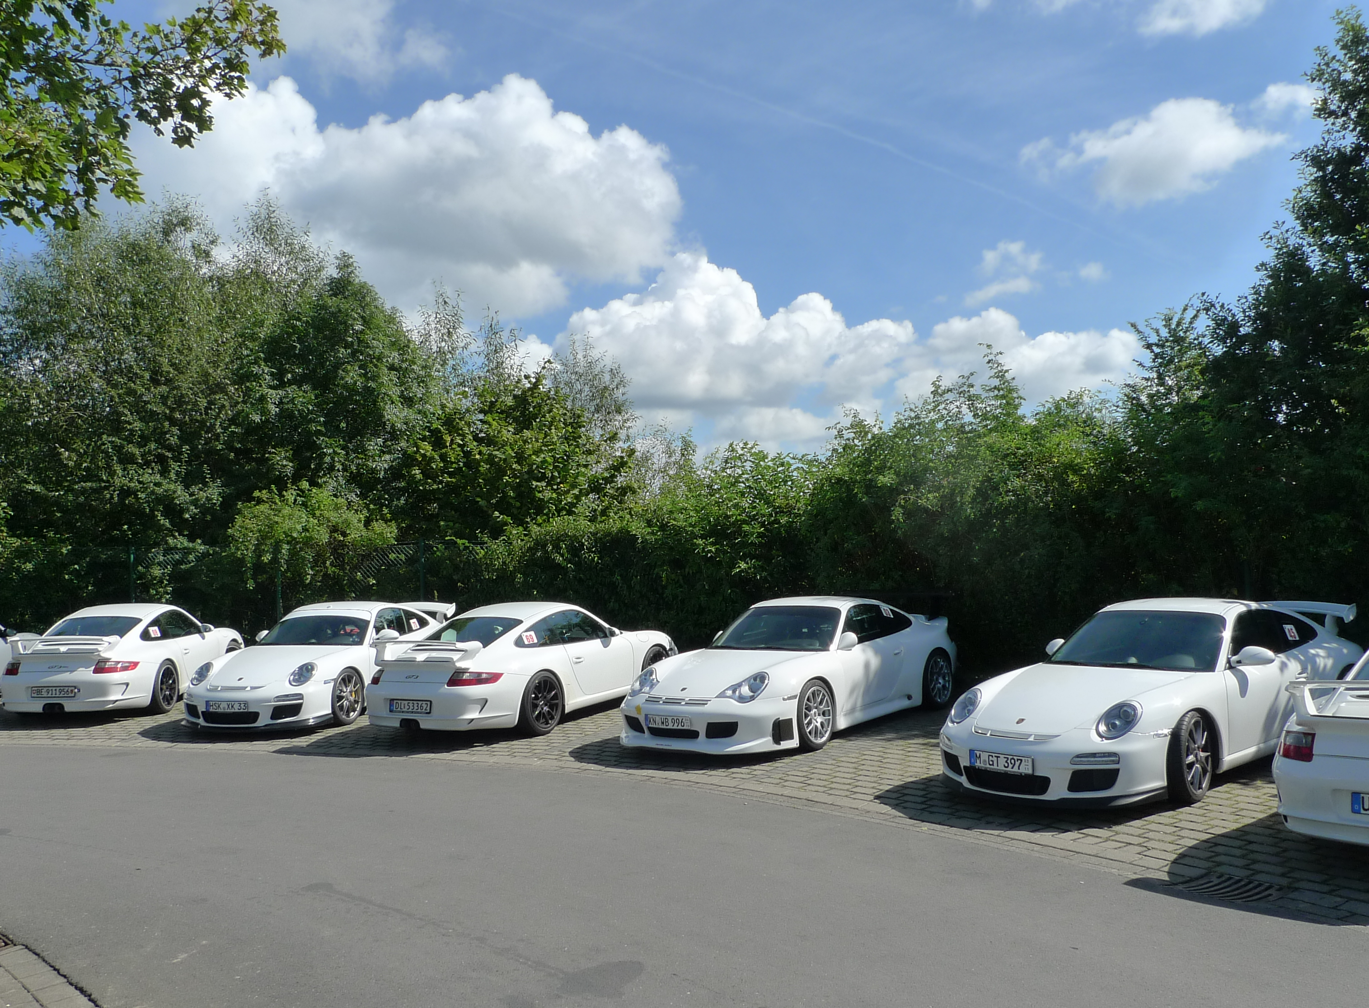
Introduction
This project is basically about parking system management (private parking)
This parking system is basically for long duration
This will help to reserve your parking space prior to your arrival
This parking system is for limited space
This Photo by Unknown Author is licensed under CC BY-NC-ND

Slide 3
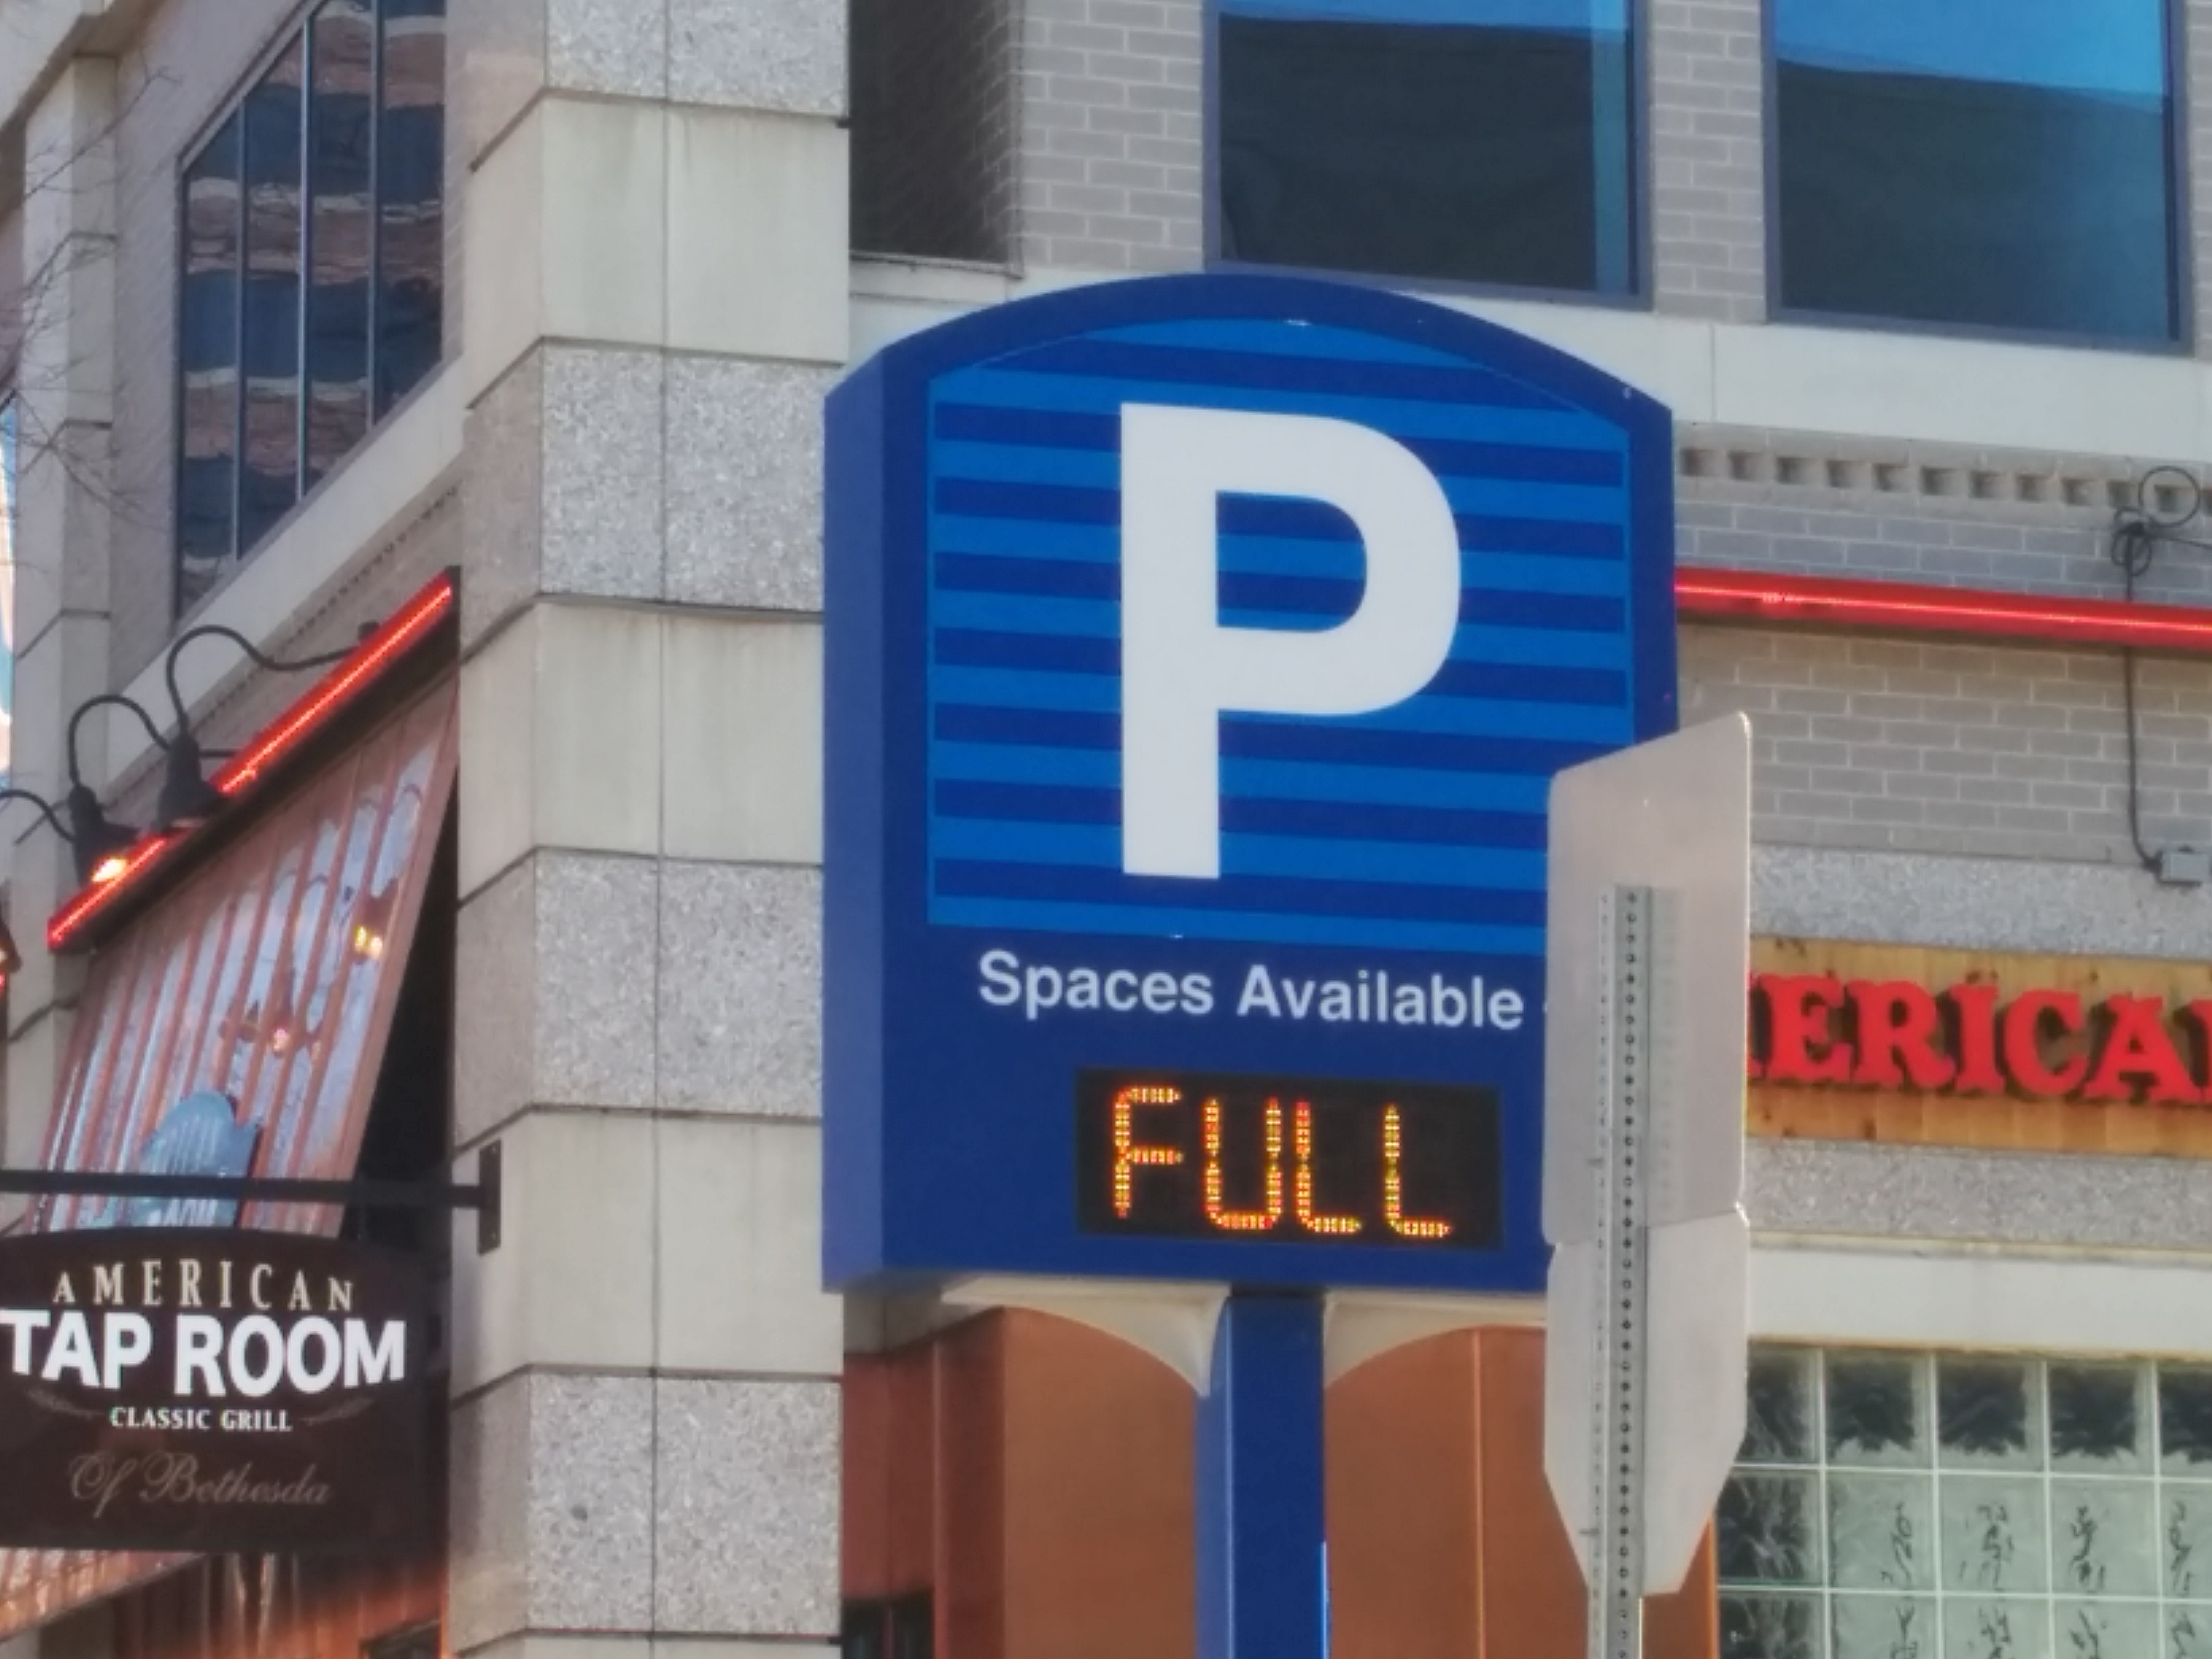
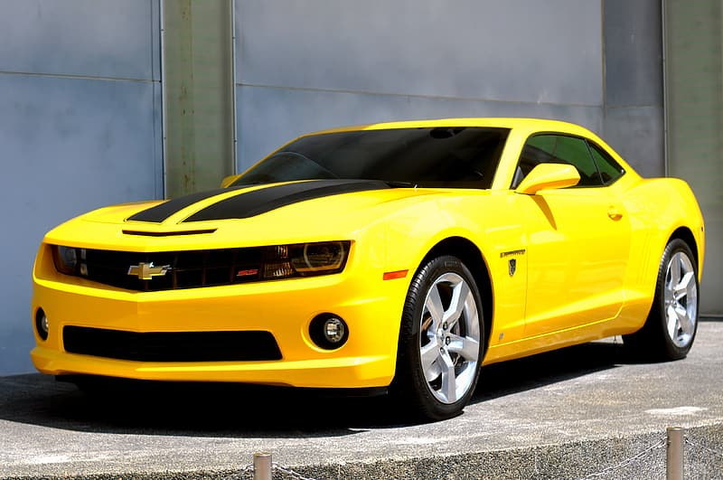
There is no other appropriate software for parking It will give notifications regarding the time limit of the vehicle in the parking, i.e., how much time is left for parking slot
It would also show the digital fee receipt according to the time for which the vehicle is parked.
It would also show better parking space according to your need like If you want to leave early it can suggest a parking near the exit gate

Slide 4
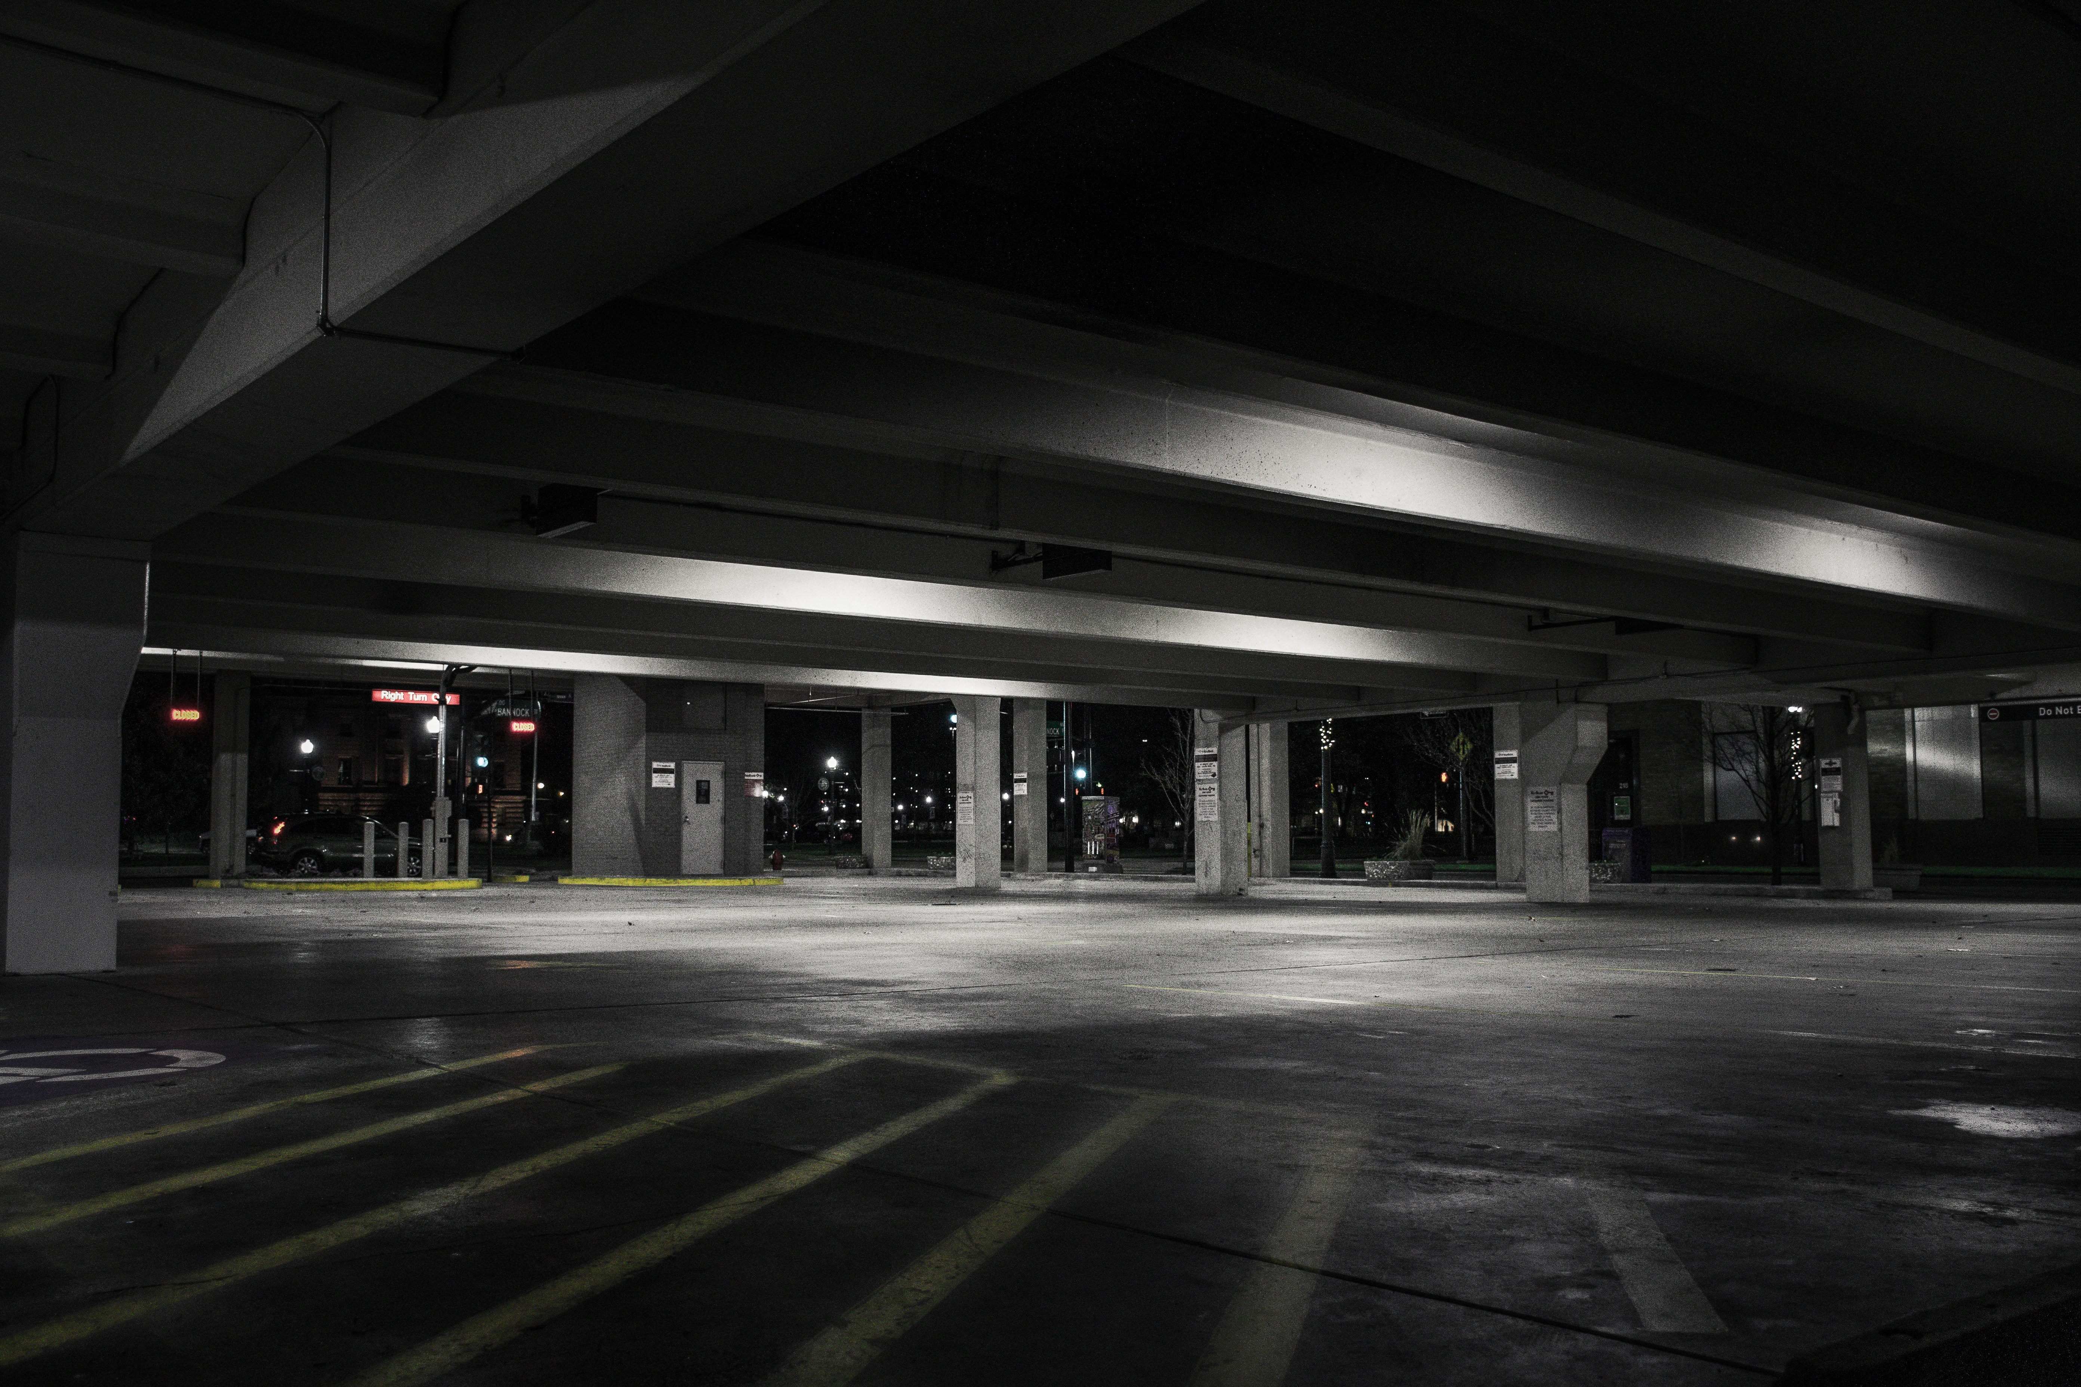

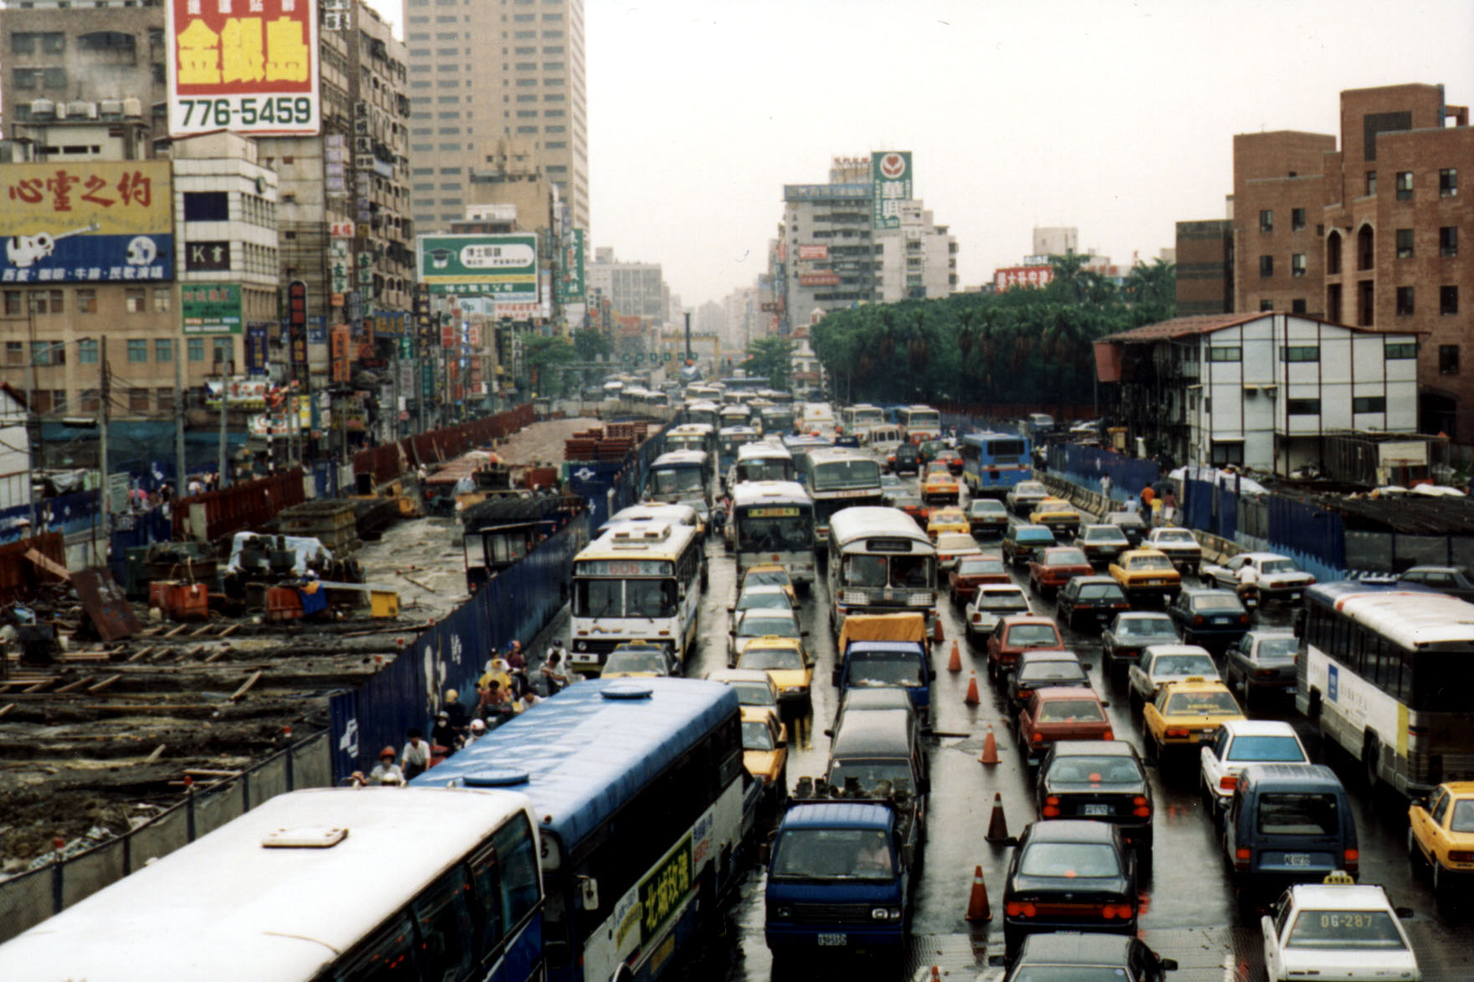
Advantages
Time-saving
Reserved parking
Less confusion
Less man-power
Digital tokens
Resolves traffic problems
No extra costs
This Photo by Unknown Author is licensed under CC BY-NC-ND

